Slide 1

COMS W4111 - Introduction to Databases
DBMS Architecture and Implementation: Disks, I/O, Indexes
Donald F. Ferguson (dff@cs.columbia.edu)
Lecture 8: Disks, I/O, Indexes

Slide 2

Module II – DBMS Architecture and Implementation
Overview and Reminder
2 | Introduction to Databases (F18): Lecture 8: Disks, I/O, Indexes

Slide 3
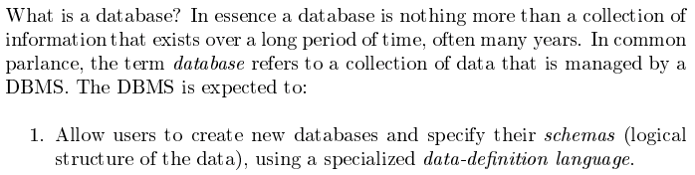
Database Management System Reminder
Covered for the relational model.
Database Systems: The Complete Book (2nd Edition) by Hector Garcia-Molina (Author), Jeffrey D. Ullman (Author), Jennifer Widom (Author)
3 | Introduction to Databases (F18): Lecture 8: Disks, I/O, Indexes © Donald F. Ferguson, 2018

Slide 4
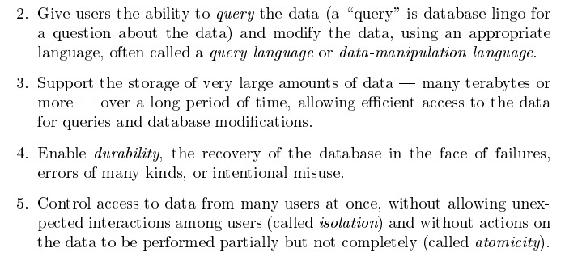
Database Management System Reminder
Focus for next part of course.
Database Systems: The Complete Book (2nd Edition) by Hector Garcia-Molina (Author), Jeffrey D. Ullman (Author), Jennifer Widom (Author)
4 | Introduction to Databases (F18): Lecture 8: Disks, I/O, Indexes © Donald F. Ferguson, 2018

Slide 5
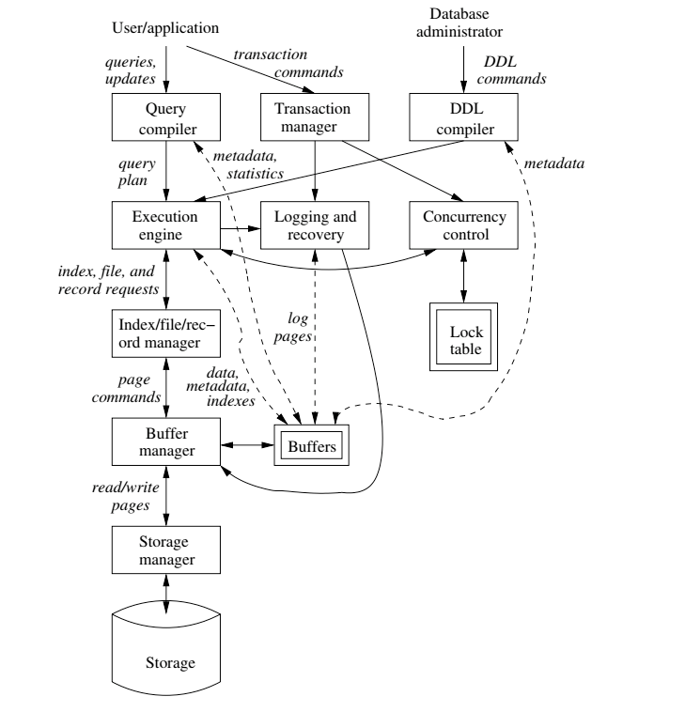
DBMS Subsystems
5 | Introduction to Databases (F18): Lecture 8: Disks, I/O, Indexes © Donald F. Ferguson, 2018

Slide 6
Disks, I/O, Indexes
6 | Introduction to Databases (F18): Lecture 8: Disks, I/O, Indexes

Slide 7
Disks as Far as the Eye Can See
7 | Introduction to Databases (F18): Lecture 8: Disks, I/O, Indexes © Donald F. Ferguson, 2018

Slide 8
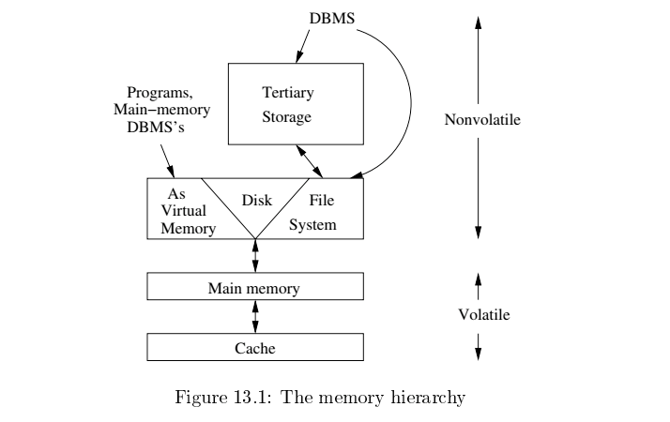
Slower
Cheaper
Unlimited
Faster
More expensive
Limited

Slide 9
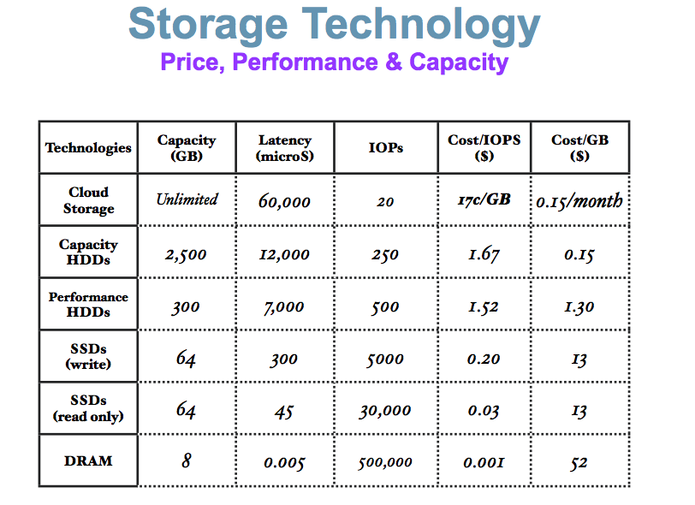
Memory Hierarchy
These numbers are ancient.
Looking for more modern numbers.
But, does give an idea of
Price
Performance
The general observation is that
Performance goes up 10X/level.
Price goes up 10x per level.
Note: One major change is improved price performance of SDD relative to HDD for large data.

Slide 11

Data Management
Find things quickly.
Access things quickly.
Load/save things quickly.
Database Systems: The Complete Book (2nd Edition) by Hector Garcia-Molina (Author), Jeffrey D. Ullman (Author), Jennifer Widom (Author)

Slide 12
Hard Disk Drive

Slide 13
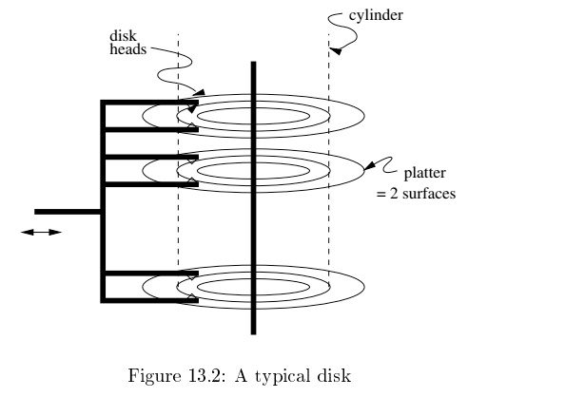
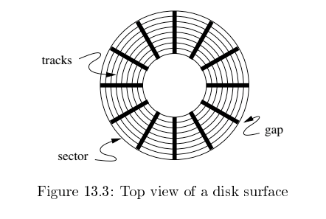
Disk Configuration
Components of disk I/O delay
Seek: Move head to cylinder/track.
Rotation: Wait for sector to get under head.
Transfer: Move data from disk to memory.
Database Systems: The Complete Book (2nd Edition) by Hector Garcia-Molina (Author), Jeffrey D. Ullman (Author), Jennifer Widom (Author)

Slide 14
Implications
I grew up in a tiny town in a very rural area.
The ”stores” were very far away and spread out.
If we were out of milk and we needed a cup of milk, we
Bought all the milk we would need for a while
AND
Anything else we needed or might need that was in the store area.
Disk I/O is the same way
Getting a block is as cheap as getting a byte.
Try to optimize your travel time by planning your trip.

Slide 15
Data Access Patterns
Think about accessing tuples in a database. The access patterns are not completely random. For example,
SELECT … ORDER BY … ➔ I look for things in sequence.
SELECT … WHERE last_name=“Smith” ➔ I look for sets of things.
CREATE VIEW AS SELECT … FROM JOIN … ON A.x=B.y ➔ I look for things in pairs of sets.
Optimizing I/O performance
Group records into blocks if accessed together.
Group blocks onto the same sector/cylinder if accessed together/sequentially ➔ Eliminates seek time.
Schedule access:
If I have to read cylinders 1, 9, 2, 8, 3
A better ordering is 1,2,3,9,8.
Stripe across disks: Read one block from 10 disks instead one 10 from 1.
Pre-fetch and preload.

Slide 16
Disk Scheduling
An example – Elevator Algorithm
Assume
The seek time from track n to m is ABS(n-m).
The I/O request queue is for sectors on tracks 1, 9, 2, 8, 3.
The head is currently on track 5.
Total seek time for FIFO processing
Seek order is 5→1→9→2→8→3
Total seek time is ABS(5-1) + ABS(1-9) + ABS(9-2) + ABS(2-8) + ABS(8-3) = 30
If the head goes all the way up and all the way down, like an elevator,
The seek order 5→8→9→3→2→1
Total seek time is ABS(5-8) + ABS(8-9) + ABS(9-3) + ABS(3-2) + ABS(2-1) = 12
There is a rich body of research and algorithms on optimizing
Blocks on tracks/sectors.
Seek/rotation optimization.

Slide 17
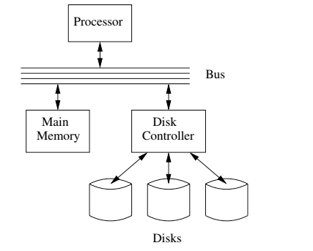
I/O Architecture
Large scale environments
The bus-controller connection is over some kind of network.
The disk controller is at the disks, and basically a “computer” with SW.
Network is either
Standard communication network, or
Highly optimized I/O network.
How we normally think of disks and I/O.

Slide 18
Hard Disk versus Solid State Disk
Hard
Disk
Drive
Solid
State
Drive

Slide 19
I/O Architecture
Solid State Disks are becoming increasingly preferred over HDD.
Faster (no rotation or seek latency).
No moving parts → more reliable.
Even for HDDs
Disk controllers supporting DBs are very sophisticated.
A lot of the placement and scheduling optimization occurs in controller.
Seek and latency considerations are less important to the DB engine, but …
The disk is still very far away.
Some of the optimization are still important.
And, availability is still an important consideration.
An example – Elevator Algorithm
Assume
The seek time from track n to m is ABS(n-m).
The I/O request queue is for sectors on tracks 1, 9, 2, 8, 3.
The head is currently on track 5.
Total seek time for FIFO processing
Seek order is 5→1→9→2→8→3
Total seek time is ABS(5-1) + ABS(1-9) + ABS(9-2) + ABS(2-8) + ABS(8-3) = 30
If the head goes all the way up and all the way down, like an elevator,
The seek order 5→8→9→3→2→1
Total seek time is ABS(5-8) + ABS(8-9) + ABS(9-3) + ABS(3-2) + ABS(2-1) = 12
There is a rich body of research and algorithms on optimizing
Blocks on tracks/sectors.
Seek/rotation optimization.

Slide 20
I/O Architecture
Redundant Array of Independent Disks (RAID)

Slide 21
RAID (https://en.wikipedia.org/wiki/RAID)
“RAID (redundant array of independent disks) is a data storage virtualization technology that combines multiple physical disk drive components into a single logical unit for the purposes of data redundancy, performance improvement, or both. (…)
RAID 0 consists of striping, without mirroring or parity. (…)
RAID 1 consists of data mirroring, without parity or striping. (…)
RAID 2 consists of bit-level striping with dedicated Hamming-code parity. (…)
RAID 3 consists of byte-level striping with dedicated parity. (…)
RAID 4 consists of block-level striping with dedicated parity. (…)
RAID 5 consists of block-level striping with distributed parity. (…)
RAID 6 consists of block-level striping with double distributed parity. (…)
Nested RAID
RAID 0+1: creates two stripes and mirrors them. (…)
RAID 1+0: creates a striped set from a series of mirrored drives. (…)
JBOD RAID N+N: With JBOD (just a bunch of disks), (…)”

Slide 22
RAID (https://en.wikipedia.org/wiki/RAID)
Clearly, we got pretty excited and inventive defining all of these options.
My experience and some independent analysis indicates that the most common levels are
RAID-0: Striping for performance.
RAID-1: Duplication for availability.
RAID-5: Striping and parity availability.
And a lot of environments do this in software using “just a bunch of disks.”
And you still have to deal with, “Don spilled coffee of the disk array controller.”
“RAID (redundant array of independent disks) is a data storage virtualization technology that combines multiple physical disk drive components into a single logical unit for the purposes of data redundancy, performance improvement, or both. (…) ]
RAID 0 consists of striping, without mirroring or parity. (…)
RAID 1 consists of data mirroring, without parity or striping. (…)
RAID 2 consists of bit-level striping with dedicated Hamming-code parity. (…)
RAID 3 consists of byte-level striping with dedicated parity. (…)
RAID 4 consists of block-level striping with dedicated parity. (…)
RAID 5 consists of block-level striping with distributed parity. (…)
RAID 6 consists of block-level striping with double distributed parity. (…)
Nested RAID
RAID 0+1: creates two stripes and mirrors them. (…)
RAID 1+0: creates a striped set from a series of mirrored drives. (…)
JBOD RAID N+N: With JBOD (just a bunch of disks), (…)”

Slide 23
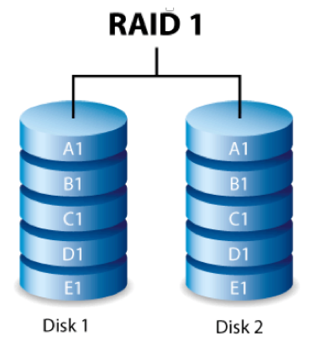
RAID-0 and RAID-1
Two physical disks make one single, logical fast disk
Two physical disks make one single, logical reliable disk
Single “Fast” Disk
Single “Reliable” Disk

Slide 24
Mixed RAID Modes
Stripe
And
Mirror

Slide 25
RAID-5
One Big Logical Disk
Improved performance through parallelism
Rotation/seek
Transfer
Availability uses parity blocks
Suppose I have 4 different data blocks on the logical drive A: A1, A2, A3, A4.
Parity function: Ap = P(A1,A2,A3,A4)
Recovery function: A2=R(Ap,A1,A3,A4)
During normal operations:
Read processing simply retrieves block.
Write processing of A2 updates A2 and Ap
If an individual disk fails, the RAID
Read
Continues to function for reads on non-missing blocks.
Implements read on missing block by recalculating value.
Write
Updates block and parity block for non-missing blocks.
Computes missing block, and calculates parity based on old and new value.
Over time
“Hot Swap” the failed disk.
Rebuild the missing data from values and parity.
Is actually 5 smaller “logical” disks.
A
B
C
D
E
Logical disk data spread over 5 physical disks.

Slide 26
Very Simple Parity Example
Even-Odd Parity
b[i] is an array of bits (0 or 1)
P(b[i]) =
0 is an even number of bits = 1. {P([0,1,1,0,1,1])= 0
1 if an odd number of bits = 1. {P(0,0,1,0,1,1]= 1
Given an array with one missing bit and the parity bit, I can re-compute the missing bit.
Case 1: [0,?,1,0,1,1] has P=0. There must be an EVEN number of ones and ?=1.
Case 2: [0,?,1,0,1,1] has P=1. There must be an ODD number of ones and ?=0.
Block Parity applies this to a set of blocks bitwise
A1=[0,1,0,0,1,1]
A2=[1,1,1,0,0,0]
A3=[0,0,0,1,0,1]
Pa=[1,0,1,1,1,0]
➔
If I am missing a block and have the parity block, I can re-compute the missing block bitwise from remaining blocks and parity block.

Slide 27
Database Address Space
27 | Introduction to Databases (F18): Lecture 8: Disks, I/O, Indexes

Slide 28
Data Address Space (Overly Simply)
The block/storage system represents block addresses with
A logical ID
That is simply a string, e.g. UUID or has some structure.
There is a logical address to physical address mapping table that maps a logical address to a physical address
Block/storage engine ID.
An opaque address string that the specific engine understands and manages.
For example, in a storage area network, the physical address might be
IP address of storage server.
ID of disk attached to the server.
{Cylinder, Head Number, Sector}
Any reference to a block, e.g. in an index node, uses the logical address.
Figuring out where, when and why to put a block in a specific engine/domain is an important optimization function in DMBS.

Slide 29
Data Address Space (Overly Simply)
Straightforward:
s-sever11.nas.myco.com
/var/dev1
The block/storage system represents block addresses with
A logical ID
That is simply a string, e.g. UUID or has some structure.
There is a logical address to physical address mapping table that maps a logical address to a physical address
Block/storage engine ID.
An opaque address string that the specific engine understands and manages.
For example, in a storage area network, the physical address might be
IP address of storage server.
ID of disk attached to the server.
{Cylinder, Head Number, Sector}
Any reference to a block, e.g. in an index node, uses the logical address.
Figuring out where, when and why to put a block in a specific engine/domain is an important optimization function in DMBS.
Most devices surface Logical Block Addressing.

Slide 30
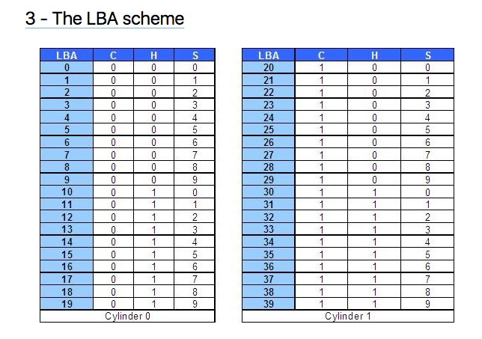
Logical Block Addressing (https://gerardnico.com/wiki/data_storage/lba)
CHS addresses can be converted to LBA addresses using the following formula:
LBA = (( C x HPC ) + H ) x SPT + S – 1
where,
C, H and S are the cylinder number, the head number, and the sector number
LBA is the logical block address
HPC is the number of heads per cylinder
SPT is the number of sectors per track
Devices have configuration and metadata APIs that allow storage manager to
Map between LBA and CHS
To optimize block placement
Based on access patterns, statistics, data schema, etc.

Slide 31
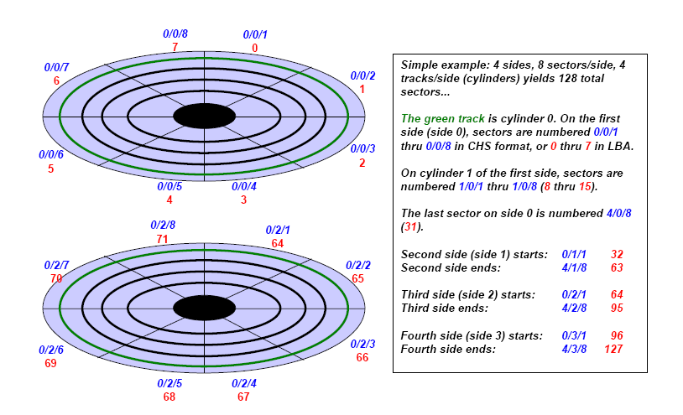
Another View (http://www.c-jump.com/CIS24/Slides/DiskDrives/D01_0150_chs_vs_lba.htm)

Slide 32
Summary
There is a broad category of storage devices
“Just a disk”
RAID-0, RAID-1, RAID-5, RAID-X/Y
Network/cloud addressable devices
SSD
A device has configuration information, often via APIs
Device geometry
Reliability metrics
IOPs, and sub-elements (seek, rotate, etc).
Storage management consists of using statistics and query (optimization patterns) to
Arrange records into blocks for storage and IO efficiency.
Place blocks on devices at LBAs to meet performance and IO objectives.

Slide 33
Summary
Almost all of this complexity and functionality is hidden from
Database developers.
Database designers and administrators.
Data center, cloud and large scale infrastructure architects
Evaluate and design disk technology and architecture
In combination with other critical technology, e.g.
Networking
Process/compute nodes.
Some customer, optimized, advanced data solutions are a combination of
Custom, optimized database implementation.
Co-designed with underlying infrastructure design.
The disk arrays and controllers do a lot of the low-level functions, but …
The database admin using DB analytics understands the access patterns.
And uses DB tools to choose, optimize and configure storage options.

Slide 34
Record and Block Management
34 | Introduction to Databases (F18): Lecture 8: Disks, I/O, Indexes

Slide 35
Terminology
A tuple in a relation maps to a record. Records may be
Fixed length
Variable length
Variable format (which we will see in Neo4J, DynamoDB, etc).
A block
Is the unit of transfer between disks and memory (buffer pools).
Contains multiple records, usually but not always from the same relation.
The database address space contains
All of the blocks and records that the database manages
Including blocks/records containing data
And blocks/records containing free space.

Slide 36
Fixed Length Record
Sample DDL
CREATE TABLE `products` ( `product_id` char(8) NOT NULL, `product_name` varchar(16) NOT NULL, `product_description` char(8) NOT NULL, `product_brand` enum('IBM','HP','Acer','Lenovo','Some really long brand name') NOT NULL, PRIMARY KEY (`product_id`) ) ENGINE=InnoDB DEFAULT CHARSET=utf8;
Why
Is this fixed length? product_brand and product_name are clearly variable length.
Isn’t char(8) to short for a product description?

Slide 37
Hypothetical Explanations
“In computing, internationalization and localization are means of adapting computer software to different languages, regional differences and technical requirements of a target locale.^{[1]} Internationalization is the process of designing a software application so that it can be adapted to various languages and regions without engineering changes. Localization is the process of adapting internationalized software for a specific region or language by adding locale-specific components and translating text. Localization (which is potentially performed multiple times, for different locales) uses the infrastructure or flexibility provided by internationalization (which is ideally performed only once, or as an integral part of ongoing development).” (https://en.wikipedia.org/wiki/Internationalization_and_localization)
Retrieving a product description may require two elements
Language code, e.g. (EN, DE, ES, …)
Description ID, e.g. 01105432
(EN, 01105432) and (DE, 01105432) are the same description in different languages (English and German)
The description ID is an attribute of the product.
The language is an attribute or property of the user, install location, etc.

Slide 38
Hypothetical Explanations
This concept is
An element of data modeling and design
Not DBMS implementation or data management.
I introduce the concept because
Important, general data model topic we have not covered.
Pattern is a reason why many records we think would be variable are often fixed.
VARCHAR field in a tuple is often
A pointer to a value in some other record.
“In computing, internationalization and localization are means of adapting computer software to different languages, regional differences and technical requirements of a target locale.^{[1]} Internationalization is the process of designing a software application so that it can be adapted to various languages and regions without engineering changes. Localization is the process of adapting internationalized software for a specific region or language by adding locale-specific components and translating text. Localization (which is potentially performed multiple times, for different locales) uses the infrastructure or flexibility provided by internationalization (which is ideally performed only once, or as an integral part of ongoing development).” (https://en.wikipedia.org/wiki/Internationalization_and_localization)
Retrieving a product description may require two elements
Language code, e.g. (EN, DE, ES, …)
Description ID, e.g. 01105432
(EN, 01105432) and (DE, 01105432) are the same description in different languages.
The description ID is an attribute of the product.
The language is an attribute or property of the user, install location, etc.

Slide 39
Hypothetical Explanation
`product_name` varchar(16) NOT NULL
(NB: Assumes that the product_name is not localized).
Length can be 0 .. 15 characters.
But,
If the value is almost always between 12 and 16 characters.
The database engine may decide to store in a fixed length area.
Because the relatively small savings available from treating like a variable length record
Does not justify the added complexity involved in variable size record management.
`product_brand` enum('IBM','HP','Acer','Lenovo','Some really long brand name')
The DB engine would/could represent with a 1 byte code in a lookup table.
This enables simplified, fixed length record management
And saves space because
1,000 products in the catalog from ‘Some really long brand’
Requires 1,000 bytes instead of 27,000 bytes.
Repeated values:
The same value occurring repeatedly in multiple distinct tuples is common, even when not an enum, e.g.
Country names, City names, street names, last names, first names, …
Foreign keys in many-to-many associative entities.
DBMS storage management engine may detect the situation, and replace values with symbol lookups.

Slide 40
Fixed Length Record
product_id
product_name
product_description
product_brand_code
Schema ID
… …
Timestamp
The record has
Database specific header fields, e.g.
Format information
Last modified
Areas for each of the fixed length fields.

Slide 41
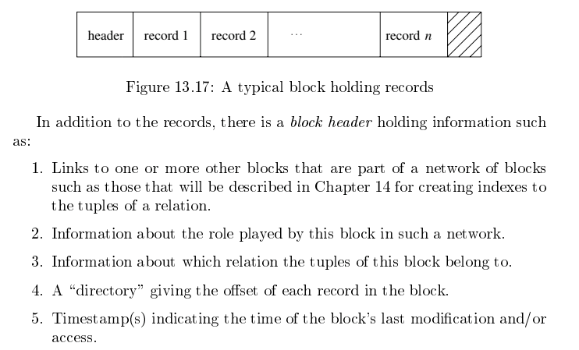
Packing Fixed Length Blocks
Database Systems: The Complete Book (2nd Edition)
by Hector Garcia-Molina and Jeffrey D. Ullman

Slide 42
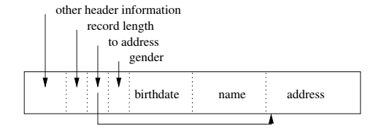
Variable Length Record
Same DBMS specific header information as fixed-length, plus
Record length.
Offset into record for each of the fields.
Variable sized areas for each of the variable sized fields.

Slide 43
Record Formats: Fixed Length
F1
F2
F3
F4
L1
L2
L3
L4
Base address (B)
Address = B+L1+L2
Information about field types same for all records in a file; stored in system catalogs.
Finding i’th field does not require scan of record.
Notes:
9

Slide 44
Record Formats: Variable Length
Two alternative formats (# fields is fixed):
F1 F2 F3 F4
4
$
$
$
$
Fields Delimited by Special Symbols
Field
Count
F1 F2 F3 F4
Array of Field Offsets
Second offers direct access to i’th field, efficient storage
of nulls (special don’t know value); small directory overhead.
Notes:
10

Slide 45
INSERT, DELETE, UPDATE
Fixed Length Records
H
R1
R4
E1
R2
E2
R3
Variable Length Records
H
R1
E1
R4
R2
R3
E2
INSERT, UPDATE and DELETE
Is pretty straightforward for fixed length records
But can get pretty interesting for variable length records, e.g.
What if INSERTed R5 is bigger than E1 or E2?
How do I expand R2?
Deleting R2 leaves a small gap → Fragmentation?

Slide 46
One (Simple) Solution is …
The block does not look like this in memory.
Variable Length Records
H
R1
E1
R4
R2
R3
E2
It always looks like this in memory …
Variable Length Records
H
R1
R4
R2
R3
E1
INSERT always goes into the start of E1.
DELETE or UPDATE R4:
Move (R2,R3) to end of R1
If R4 updated, move to end of new position of R3.

Slide 47
One (Simple) Solution is …
The block does not look like this in memory.
Variable Length Records
Before UPDATE (and resize) of R4
H
R1
E1
R4
R2
R3
E2
H
R1
R4
R2
R3
E1
It always looks like this in memory …
After UPDATE (and resize) of R4
Variable Length Records
H
R1
R2
R3
R4
E1
INSERT always goes into the start of E1.
DELETE or UPDATE R4:
Move (R2,R3) to end of R1
If R4 updated, move to end of new position of R3.
And this is the format the engine writes to disk.

Slide 48
Page Formats: Fixed Length Records
Slot 1
Slot 1
Slot 2
Slot 2
. . .
Free
Space
. . .
Slot N
Slot N
Slot M
N
1
. . .
1
1
0
M
number
of records
M ... 3 2 1
number
of slots
PACKED
UNPACKED, BITMAP
Record id = <page id, slot #>. In first alternative, moving records for free space management changes rid; may not be acceptable.
Notes:
11

Slide 49
Page Formats: Variable Length Records
Rid = (i,N)
Page i
Rid = (i,2)
Rid = (i,1)
20
16
24
N
Pointer
to start
of free
space
N . . . 2 1
# slots
SLOT DIRECTORY
Can move records on page without changing rid; so, attractive for fixed-length records too.
Notes:
12

Slide 50
Block and Record Addresses
Disk Room 1
Blocks and records have addresses
Index tables map an index entry to {block, record}
SELECT scan on a table needs a logical linked list of the blocks holding records, e.g. “next block.”
Index elements are themselves blocks, and need to reference other nodes in the index.
But, …
The blocks can be all over the place, and
Each “place” has a different address format and access protocol.
Disk Room 2
Cloud 1
Tape Library
Cloud 2

Slide 51
Data Address Space (Overly Simply)
The block/storage system represents block addresses with
A logical ID
That is simply a string, e.g. UUID or has some structure.
There is a logical address to physical address mapping table that maps a logical address to a physical address
Block/storage engine ID.
An opaque address string that the specific engine understands and manages.
For example, in a storage area network, the physical address might be
IP address of storage server.
ID of disk attached to the server.
{Cylinder, Track, Sector}
Any reference to a block, e.g. in an index node, uses the logical address.
Figuring out where, when and why to put a block in a specific engine/domain is an important optimization function in DMBS.

Slide 52
Buffer Pools
52 | Introduction to Databases (F18): Lecture 8: Disks, I/O, Indexes

Slide 53
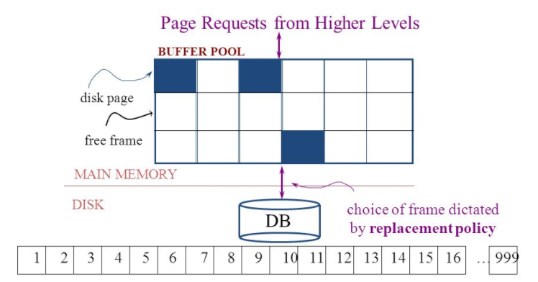
The Logical Concept
The DBMS and queries can only manipulate in-memory blocks and records.
A very, very, very small fraction of all blocks fit in memory.

Slide 54
When a Page is Requested ...
If requested page is not in pool:
Choose a frame for replacement
If frame is dirty, write it to disk
Read requested page into chosen frame
Pin the page and return its address.
If requests can be predicted (e.g., sequential scans)
pages can be pre-fetched several pages at a time!
Notes:
5

Slide 55
More on Buffer Management
Requestor of page must unpin it, and indicate whether page has been modified:
dirty bit is used for this.
Page in pool may be requested many times,
a pin count is used. A page is a candidate for replacement iff pin count = 0.
CC & recovery may entail additional I/O when a frame is chosen for replacement. (Write-Ahead Log protocol; more later.)
Notes:
6

Slide 56
Buffer Replacement Policy
Frame is chosen for replacement by a replacement policy:
Least-recently-used (LRU), Clock, MRU etc.
Policy can have big impact on # of I/O’s; depends on the access pattern.
Sequential flooding: Nasty situation caused by LRU + repeated sequential scans.
# buffer frames < # pages in file means each page request causes an I/O. MRU much better in this situation (but not in all situations, of course).
Notes:
7

Slide 57
DBMS vs. OS File System
OS does disk space & buffer mgmt: why not let OS manage these tasks?
Differences in OS support: portability issues
Some limitations, e.g., files can’t span disks.
Buffer management in DBMS requires ability to:
pin a page in buffer pool, force a page to disk (important for implementing CC & recovery),
adjust replacement policy, and pre-fetch pages based on access patterns in typical DB operations.
Notes:
8

Slide 58
Replacement Policy
The replacement policy is one of the most important factors in database management system implementation and configuration.
A very simple, introductory explanation is (https://en.wikipedia.org/wiki/Cache_replacement_policies).
There are a lot of possible policies.
The most efficient caching algorithm would be to always discard the information that will not be needed for the longest time in the future. This optimal result is referred to as Bélády's optimal algorithm/simply optimal replacement policy or the clairvoyant algorithm.
All implementable policies are an attempt to approximate knowledge of the future based on knowledge of the past.
Least Recently Used is based on the simplest assumption
The information that will not be needed for the longest time.
Is the information that has not been accessed for the longest time.

Slide 59
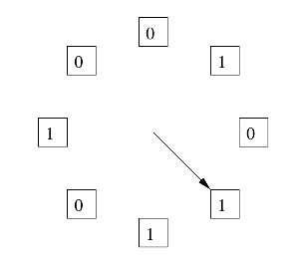
The “Clock Algorithm”
LRU is (perceived to be) expensive
Maintain timestamp for each block.
Update and resort blocks on access.
The “Clock Algorithm” is a less expensive approximation.
Arrange the frames (places blocks can go) into a logical circle like the seconds on a clock face.
Each frame is marked 0 or 1.
Set to 1 when block added to frame.
Or when application accesses a block in frame.
Replacement choice
Sweep second hand clockwise one frame at a time.
If bit is 0, choose for replacement.
If bit is 1, set bit to zero and go to next frame.
The basic idea is. On a clock face
If the second hand is currently at 27 seconds.
The 28 second tick mark is “the least recently touched mark.”

Slide 60
Replacement Algorithm
The algorithms are more sophisticated in the real world, e.g.
“Scans” are common, e.g. go through a large query result in order (will be more clear when discussing cursors).
The engine knows the current position in the result set.
Uses the sort order to determine which records will be accessed soon.
Tags those blocks as not replaceable.
(A form of clairvoyance).
Not all users/applications are equally “important.”
Classify users/applications into priority 1, 2 and 3.
Sub-allocate the buffer pool into pools P1, P2 and P3.
Apply LRU within pools and adjust pool sizes based on relative importance.
This prevents
A high access rate, low-priority application from taking up a lot of frames
Result in low access, high priority applications not getting buffer hits.

Slide 61
Summary
Like all other aspects of DMBS implementation
Block management
Buffer management
Are incredibly complex, heavily researched topics.
This course section has just skimmed the surface
Awareness of concepts.
Foundation for future more advanced courses.
Understand concepts to consider, research, prototype, etc. if you have to implement your own data management engine.

